Slide 1
絕對方向底盤程式
Absolute Direction Drive

Slide 2
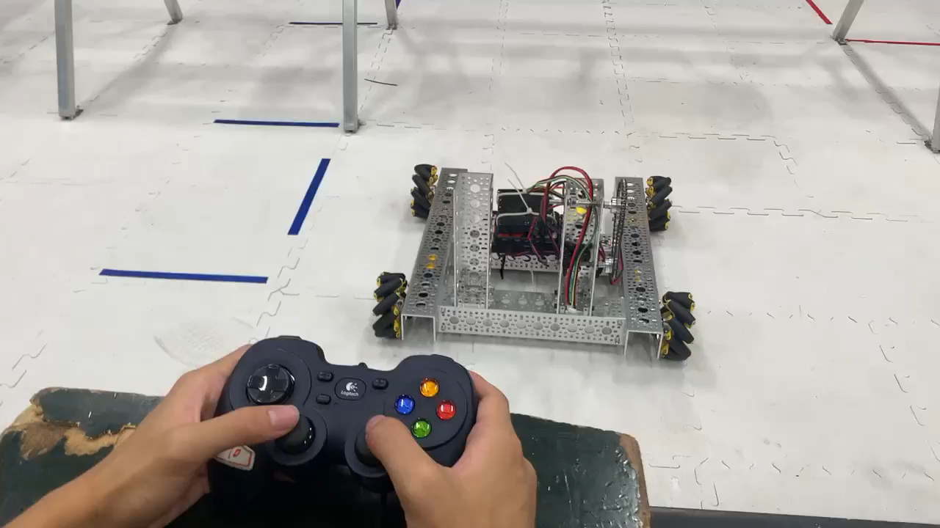

Slide 3


Slide 4
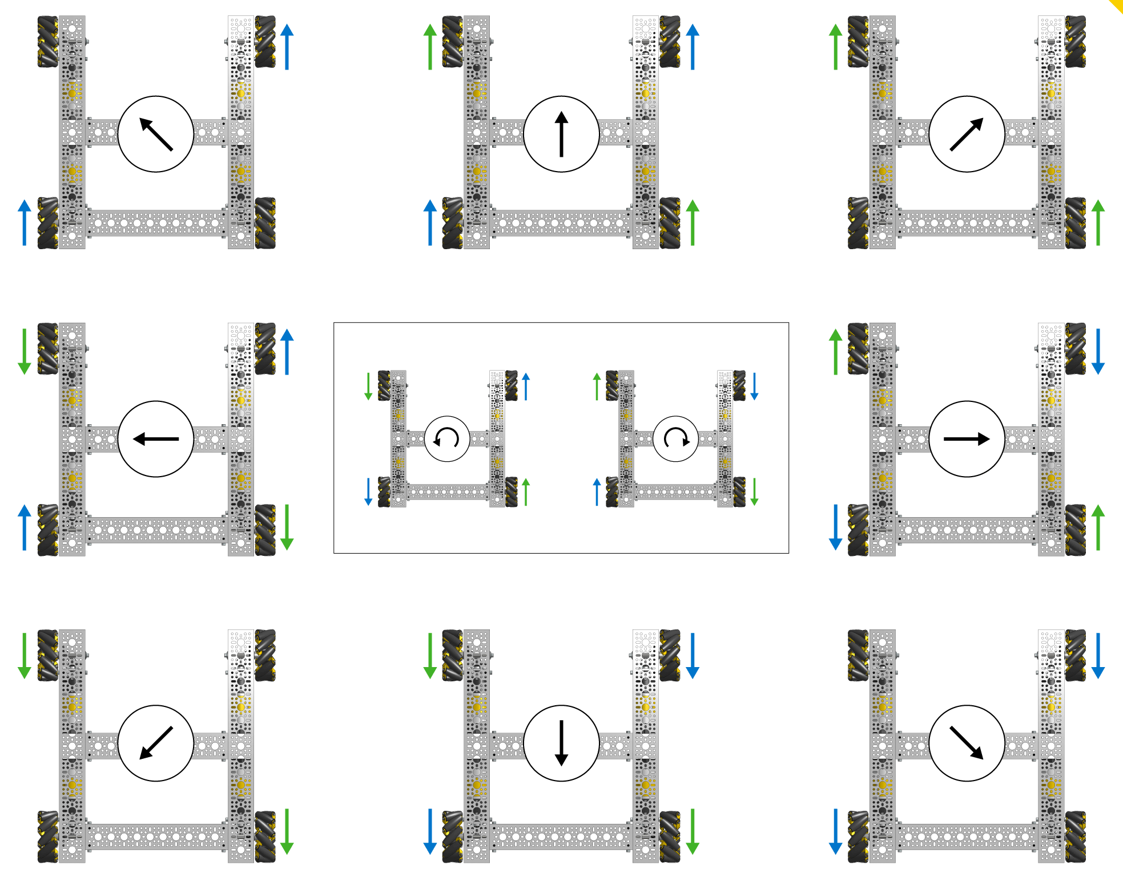

Slide 5
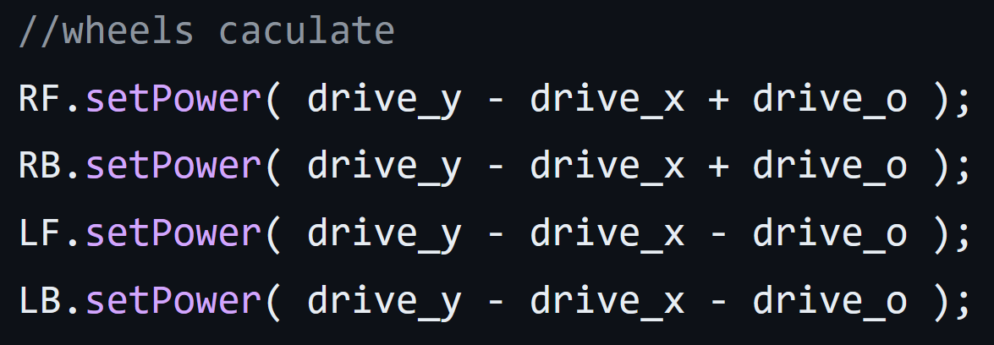

Slide 6
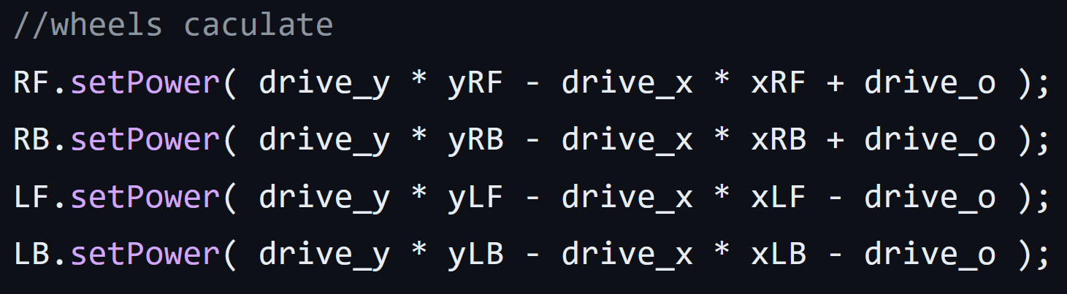

Slide 7
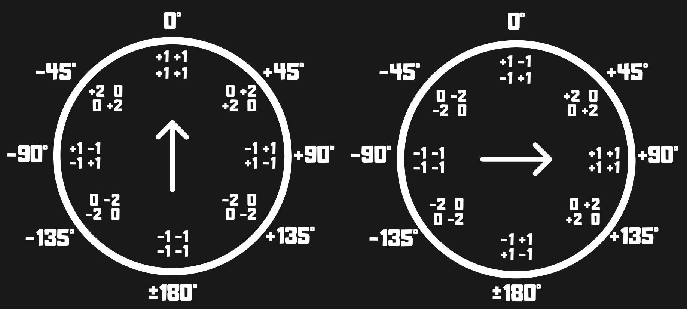

Slide 8
資源分享
FTC official Github
FTC official programming resources
Virtual Robot Simulator
xRC Simulator
Game Manual 0
Learn Road Runner
AprilTag Github
The Orange Alliance
FTC Discord
FTC Taiwan Discord
FTC Reddit

